Slide 1
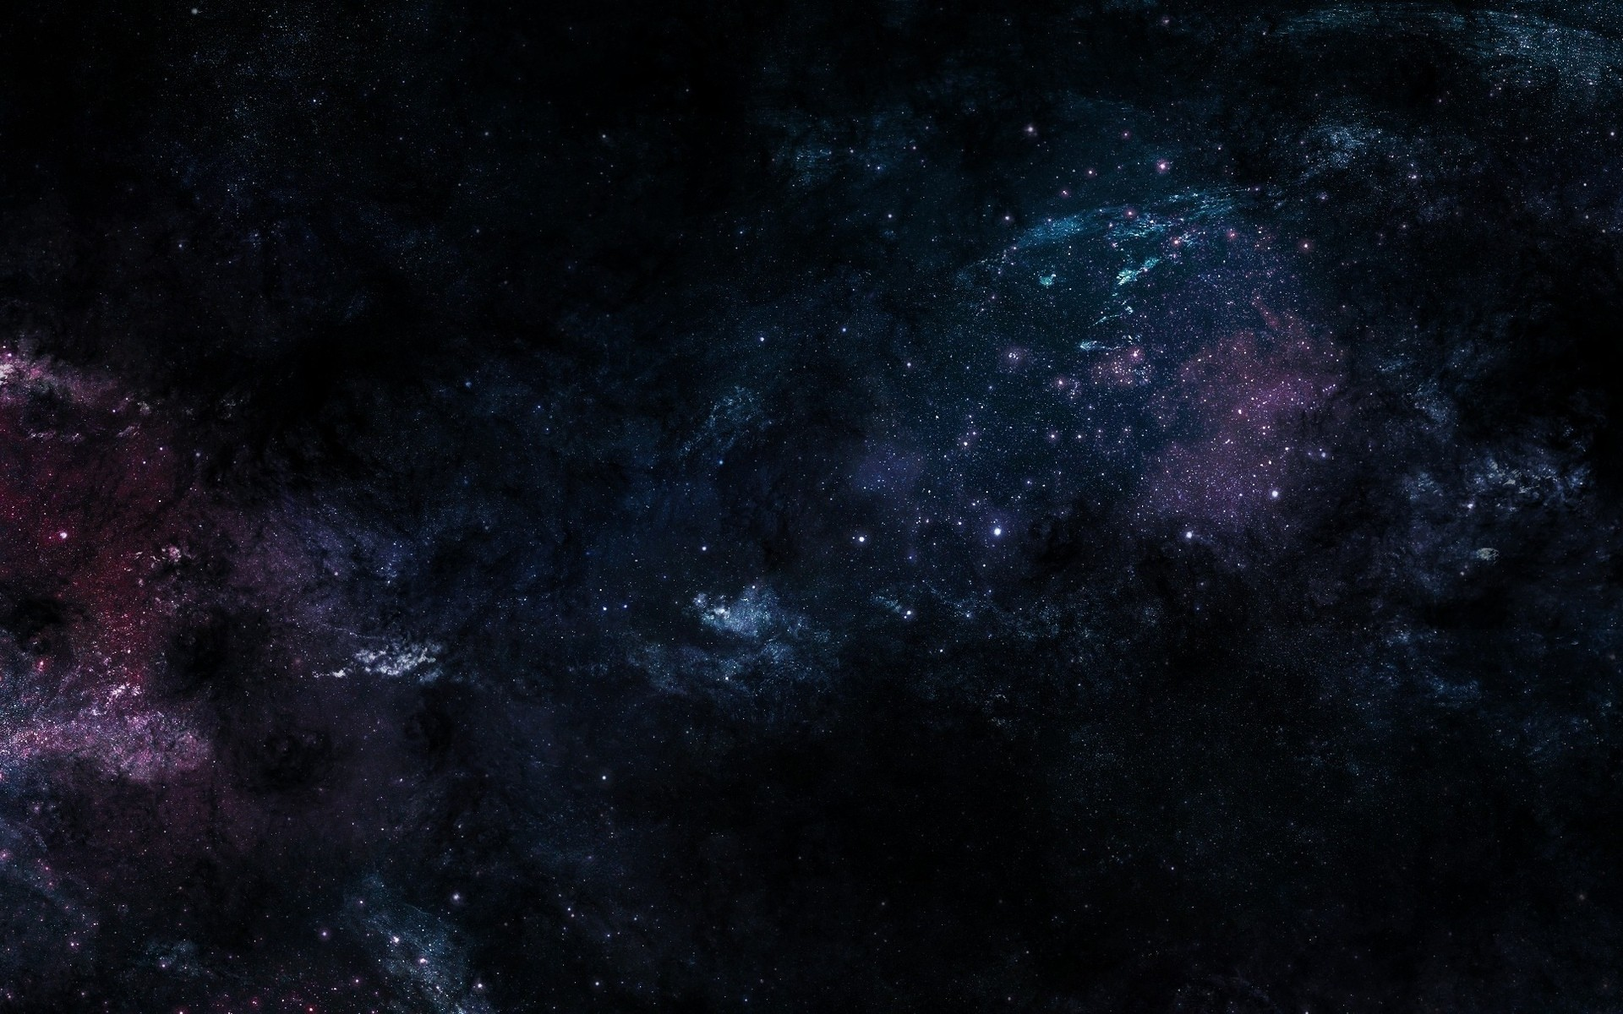



Space Environment Radiation Testing On Electrical Components
Mairely Urias, Hugh Barnaby
ASU School of Electrical, Computer and Energy Engineering
2022 Arizona NASA Space Grant Symposium
April 23, 2022

Slide 2
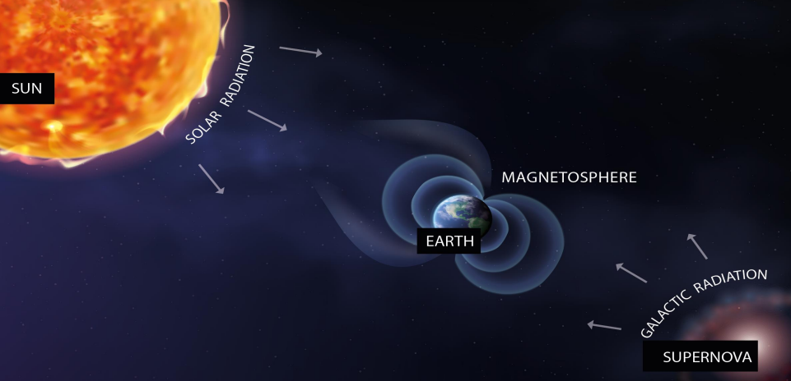
Sources of Radiation in Space
Radiation: energy that is emitted in the form of rays, electromagnetic waves, and/or particles
Space Radiation: made up of atoms in which electrons have been stripped away as atom accelerates in interstellar space to speeds approaching speed of light = Ionizing Radiation
Sources
Particles trapped in Earth’s magnetic field
Solar Particle Events
Galactic Cosmic Rays

Slide 3
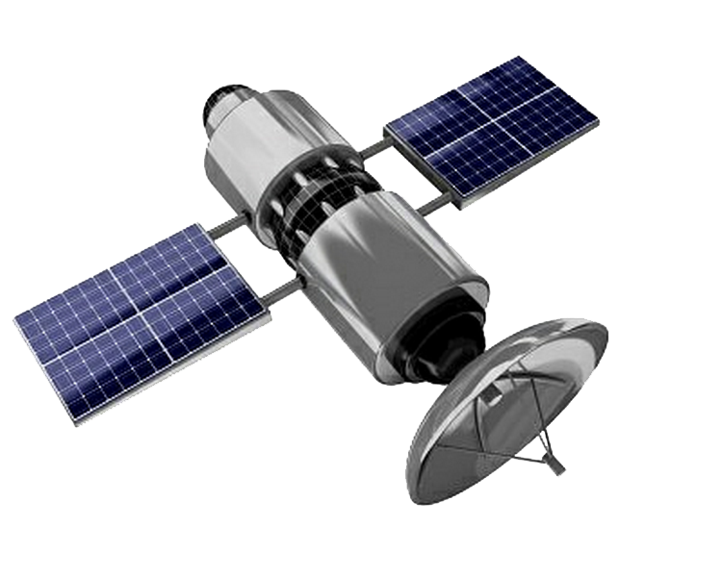
Radiation Effects in Electronics
Upsets/Anomalies:
Loss of data
Spurious signals
Phantom commands
Performance degradation
Single event effects (SEE) in microelectronics:
1101 → 0101
Electromagnetic pulses
Effects can range from being transient, cumulative, permanent, recoverable or destructive
SYSTEM FAILURE

Slide 4
Single Event Effects
Total Ionizing Dose
vs.
Individual Incidents
Single highly energetic particle
Soft Errors
Non-destructive, may appear as bit flip, logic transients
Hard Errors
Permanent functional effect
May or may not be destructive
Latch-up, burnout, gate rupture
Cumulative, long-term
Caused by all ionizing radiation sources
Performance Deterioration
Potentially leads to system failure over time
Voltage shifts, leakage currents, gain degradation

Slide 5
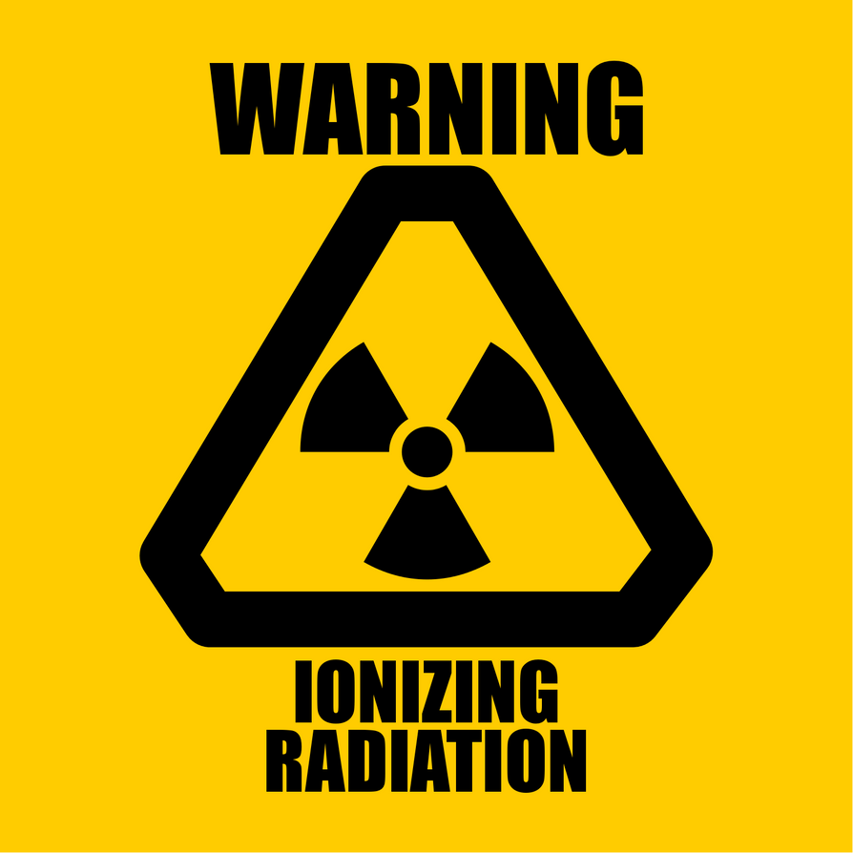
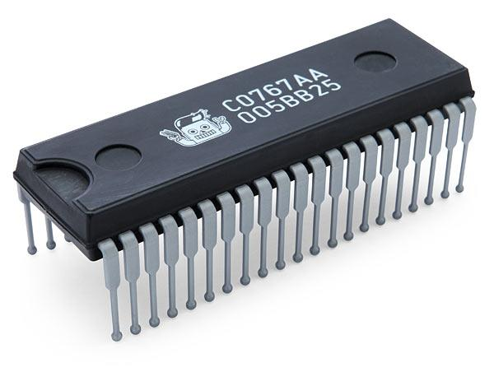
For example…
Analog Failure
Performance Degradation
Operational Failure
Digital Failure
Memory Corruption
Soft Errors (SEE)
1101→ 0101
Integrated Circuit
Code and Algorithm Failure
Code Corruption
Power Failure
Power Control Malfunction

Slide 6
Radiation Hardening By Design
1. Identify Failure Mechanisms
GOALS
Increase Reliability
Increase Lifespan
Reduce/Eliminate Susceptibility to Failure Mechanisms
2. Identify Radiation Effects Responsible
3. Measure Radiation Effects & Failure Mechanisms
4. Use Knowledge to Improve Design

Slide 7
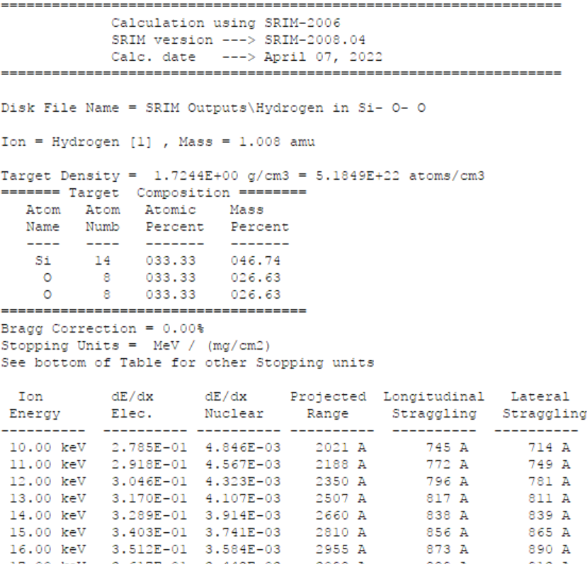
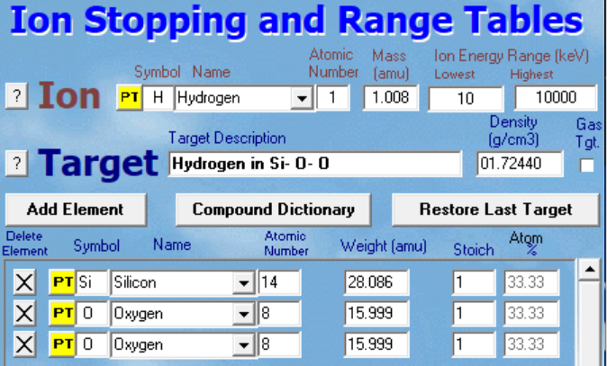
Radiation Testing
Linear Energy Transfer (LET): energy deposited per unit track length, normalized to density (MeV-cm²)
Total Ionizing Dose (TID): measure of energy absorbed by a unit mass per matter, or rad, by ionizing radiation.
Selecting Constraints

Slide 8
Converting Fluence to Rad(SiO₂)
rad(SiO₂) = K × φ_{p} × LET
Units of rad(Si) = (rad⋅g/MeV) × (cm⁻²) × (MeVcm²/g)
K = (10⁶eV/MeV)(1.6 × 10⁻¹²erg/eV)(1rad ⋅ g/100 erg)
= 1.6 × 10⁻⁸ rad⋅g/MeV
Ex: 100 MeV protons in SiO₂
- LET for 100 MeV in SiO₂ is 6.13 MeVcm²/g (from SRIM)
- Total dose: [rad(SiO₂) ] from 100 MeV proton fluence (φ_{p} ), multiply φ_{p} by (6.13) (1.6 × 10⁻⁸ )
If the total fluence of 100 MeV protons for the mission is 10¹² protons/cm², the part will receive ~ 100 krad (SiO₂) from these particles.

Slide 9
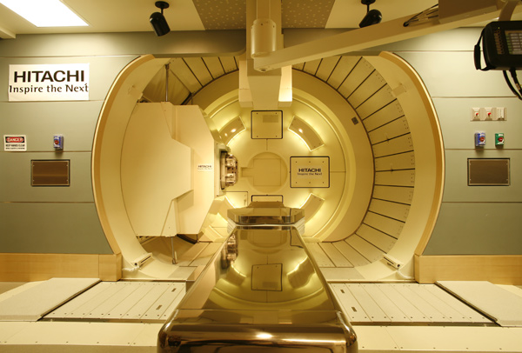
Radiation Testing
Proton beam irradiates electrical components, simulating space environment
Selected Constraints:
100 MeV protons
5 mm diameter beam at 90% uniformity
Test up to 10¹³ cm⁻² fluence with intermediary measurement points at 10¹¹,2×10¹¹,5×10¹¹, 10¹²,2×10 ¹² , 5×10¹²,10 ¹³ cm⁻² .
Hitachi ProBeat IV synchrotron-based pencil beam scanning system at the Mayo Clinic, Phoenix, AZ

Slide 10
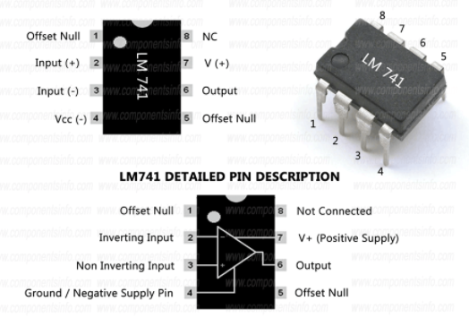
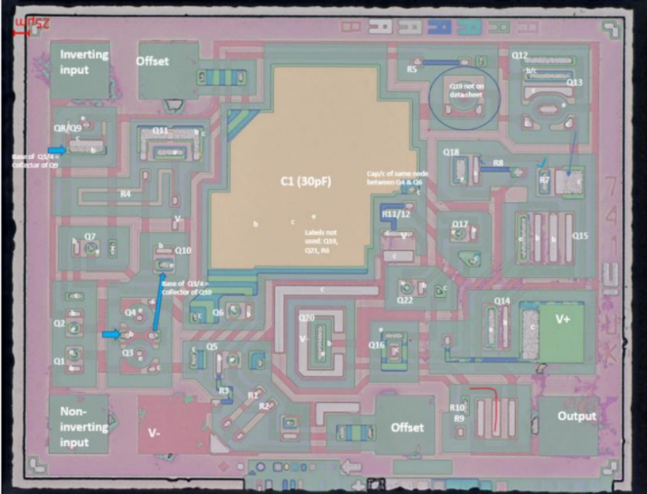
Radiation Testing
Components:
LM741 OpAmp
Overload protection on input and output (prevents possible circuit damage)
No latch-up when range is exceeded (allows device to function properly without having to power cycle.
Freedom from oscillations
General purpose op amp, commonly used as noninverting
Estimated Time:
4 hours beam time
LM741 Pin Description
Reverse
engineered LM741
die photo

Slide 11
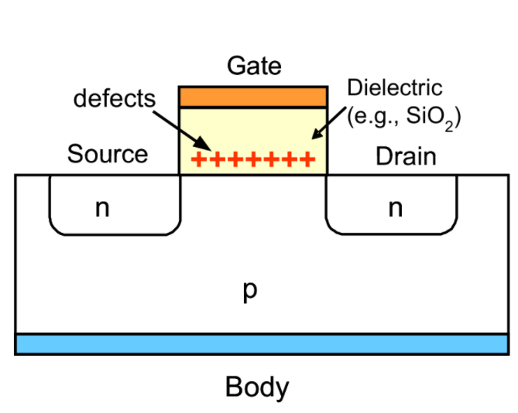
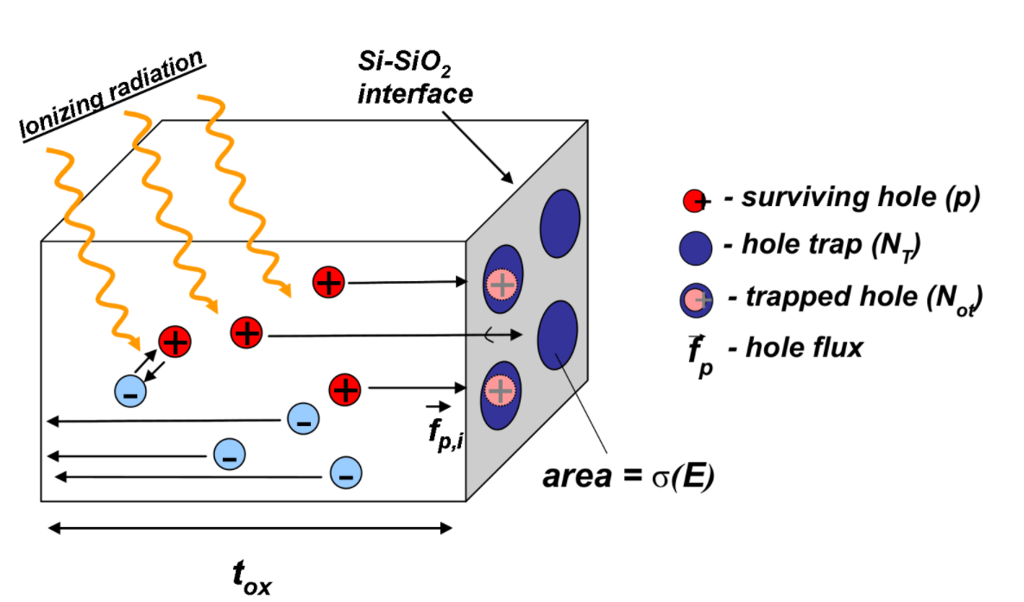
Damages to Assess Post Irradiation
Changed Transistor Parameters
Electron-hole pairs
Current Leakages
Figures obtained from: Barnaby, Hugh. Schrimpf, Ron. Total Dose Effects in Solid State Materials and Devices. 2010. [PowerPoint Presentation]. SERESSA 2010

Slide 12
Anticipated Results
Short Term Exposures (<1 × 10⁹ cm⁻²):
Results supporting analysis of Single Event Effect susceptibilities in selected transistors and circuits
Long Term Exposures (>1 × 10¹⁰ cm⁻²):
Results supporting analysis of combined TID and displacement damage susceptibilities
Conclusions: With the data obtained from these studies, we will analyze radiation responses to further improve survivability of electrical components in the harsh radiation space environment

Slide 13
Questions?

Slide 14
Acknowledgements
A special thanks to :
Dr. Hugh Barnaby, for the guidance and mentorship
Dr. Daniel Robertson and the Radiation Oncology Research Committee at the Mayo Clinic for allowing and facilitating the use of proton beam for academic use
ASU/NASA Space Grant Consortium

